Slide 1
Micromap Extensions For Conditioned Micromaps and Comparative Micromap Series
By
Daniel B. Carr
George Mason University
Chunling Zhang
GMU/IBM
June 1, 2011

Slide 2
Communicating and Thinking With Statistical Maps
Maps are useful for communication
Many people like them
Convey spatial context
Maps are useful for thinking
Many people organize information in terms of locations or maps
Network of connections facilitates memory
Spatial patterns trigger hypothesis generation
Mapping fitted values and residuals can be part of a model criticism tool kit
Location provide a surrogate for variables not in a model
Map viewing designs can be improved
Make spatial patterns pop out, limit distracters, support focus
Help people think with more than one variable
Facilitate comparison tasks and address change blindness
Provide interactive options to engage people in thinking with statistics
Provide education pathways toward more sophisticated statistical methods

Slide 3
Micromaps Overview
Micromap definition
Graphics using an organized set of small maps to help in representing statistics
Small map redesign suggestions for regions
Simplify boundaries: Generalizations or caricatures of common maps
Preserve recognition: Keep region neighbors
Keep distinctive facet(s) of shape
Visibility: Enlarge small regions
Use more saturated color for encodings
Map encodings
Regions as polygons, networks as polylines, places as points

Slide 4
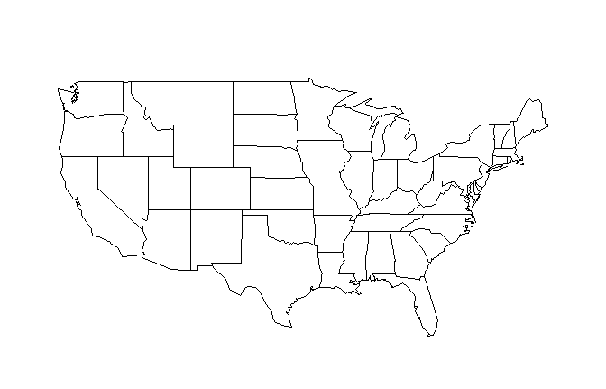
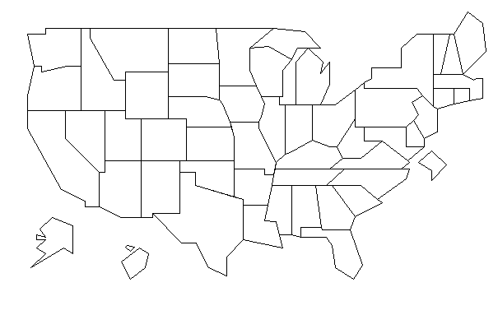
Small maps can be caricatures
of maps having high resolution boundaries
Continental US State map
Longitude and latitude projection
State Visibility Map
Adapted from Mark Monmonier

Slide 5
Kinds of Micromaps
Linked Micromaps
Sorts and groups regions to create small multiples
Links region statistics in graphics panels to map locations
Purpose: Adding context for communication and data exploration
Conditioned Micromaps
Two sliders partition regions into a 3 x 3 grid of maps
One slider controls region color.
Purpose: Data exploration and hypothesis generation using 3 variables
Hypothesis test partitioning of regions
Purpose: Communicate status and trends based on hypothesis tests
Comparative Micromaps
Show one- or two-way indexed map series and change map variants
One slider controls global series color for many layouts
Purpose: Emphasize spatial context, address change blindness

Slide 6
Conditions Yielding Three Classes For Comparisons
Why three?
We can only handle 3 or 4 simple items in working memory
Easy to describe and think
Compare region values to two thresholds
Classes: low, middle, high
Action: Adjust thresholds - conditioning sliders
Hypothesis tests comparing values to a reference value
Compare state values to the national value, preferred state value, or chosen value
Classes: Below, Similar To , Above
Action: Select value, adjust significance level
Practical significance tests based on differences or ratios
Classes: Below, Similar To, Above
Action: Seek community consensus for thresholds

Slide 7
State Cancer Profiles: Hypothesis Test Partitioning of States
Lung & Bronchus Cancer Death Rates and Trends: Females, All Races, 2005
 | Above US Rate | Similar to US Rate | Below US Rate
Rising Tend | Arkansas Indiana Kansas Kentucky Louisiana Maine Ohio Oklahoma Tennessee | Alabama Georgia Iowa Michigan Mississippi Montana Nebraska North Carolina Pennsylvania South Carolina South Dakota Wisconsin | Colorado Hawaii Idaho Minnesota North Dakota Utah
Stable Trend | Delaware Missouri Nevada Oregon West Virginia | Alaska Connecticut Florida Illinois Maryland Massachusetts New Hampshire New Jersey Rhode Island Vermont Virginia Wyoming | Arizona New Mexico
Falling Trend |  | District of Columbia New York Texas Washington | California

Slide 8
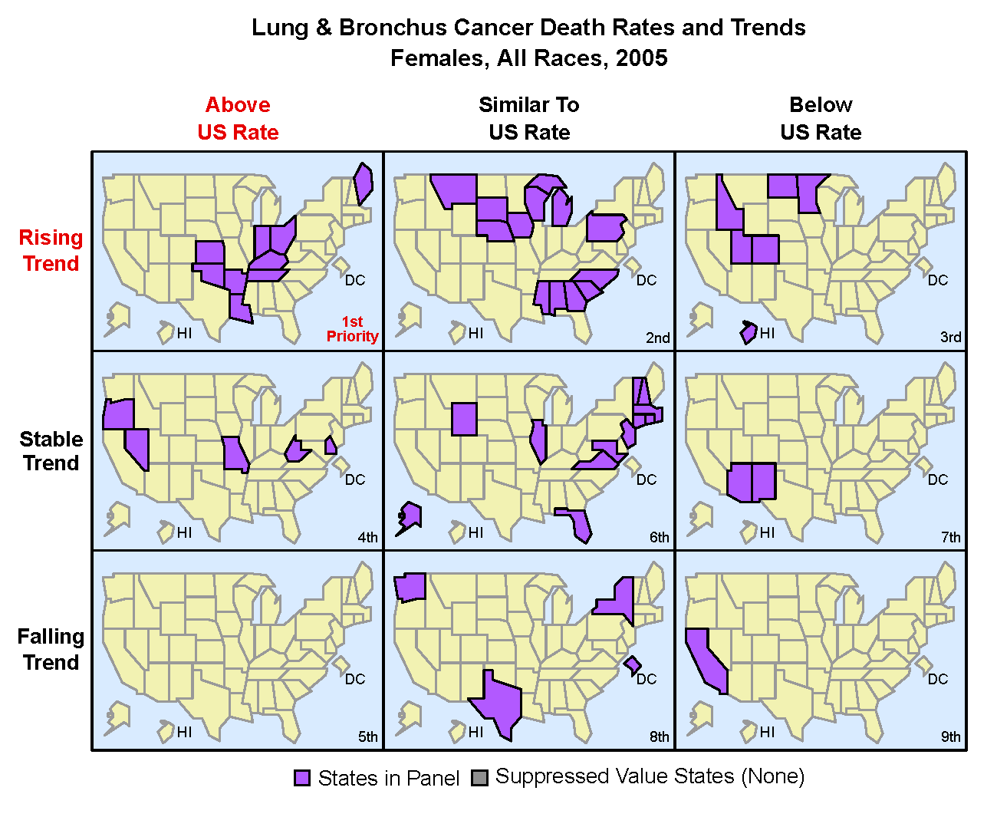
Conditioned Maps Can Show the Spatial Patterns
From Carr and Pickle 2010

Slide 9
State Cancer Profiles Documentation
Trend²
Rising when 95% confidence interval of average annual percent change is above 0. Stable when 95% confidence interval of average annual percent change includes 0. Falling when 95% confidence interval of average annual percent change is below 0.
Rate Comparison Above when 95% confident the rate is above and Rate Ratio³ > 1.10 Similar = when unable to conclude above or below with confidence. Below when 95% confident the rate is below and Rate Ratio³ < 0.90
² Recent trend in death rates is Average Annual Percent Change (AAPC) based on the APCs calculated by Joinpoint Regression Program. Due to data availability issues, the time period used in the calculation of the joinpoint regression model may differ for selected racial groups or counties.
³ Rate ratio is the county rate divided by the US rate.
See http://statecancerprofiles.cancer.gov/rt_choice.html

Slide 10
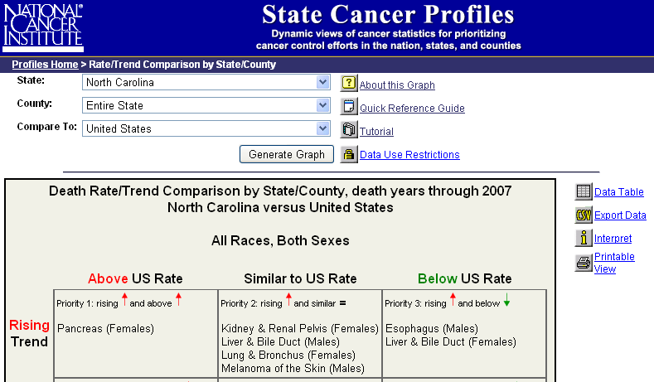
What About Cancer Mortality in North Carolina?

Slide 11
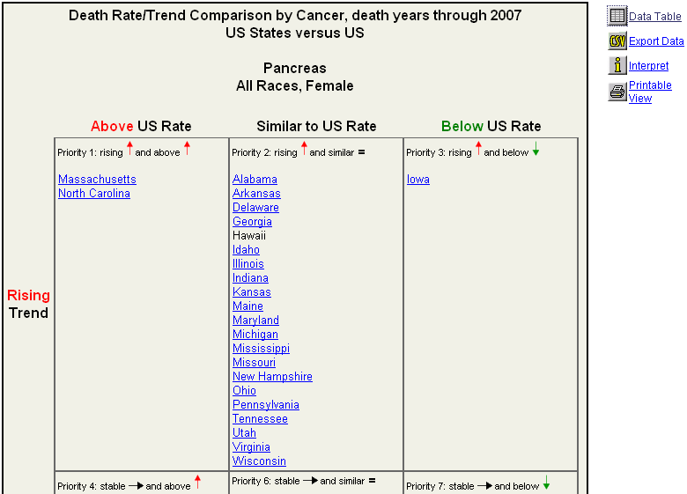
What About Rates and Trends for other States?

Slide 12
Shifting to Examples for National Assessment of Educational Progress
The National Center For Educational Statistics
http://nces.ed.gov/nationsreportcard/states/
Assessment areas: Mathematics, reading, science and more
Categories: Selected grades, years and population subsets
Statistics: Averages and select percentiles
Percents in below basic, basic, proficient and advance
achievement level categories
Reporting: Maps, statistical graphics and tables including
hypothesis tests

Slide 13
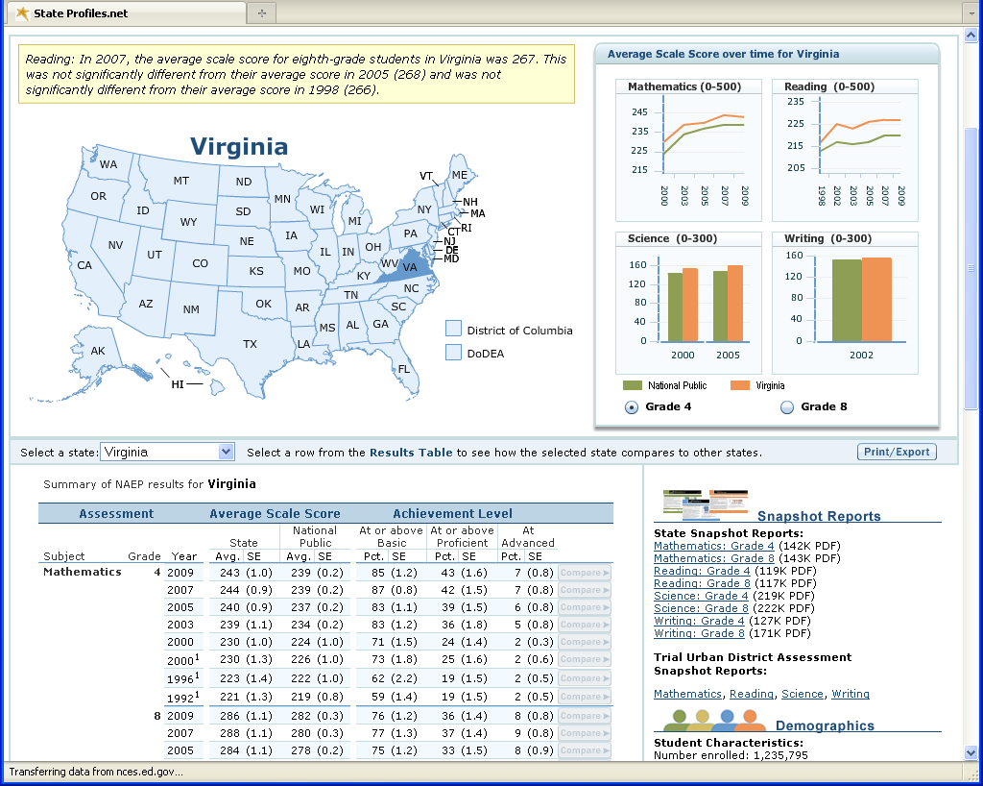

Slide 14
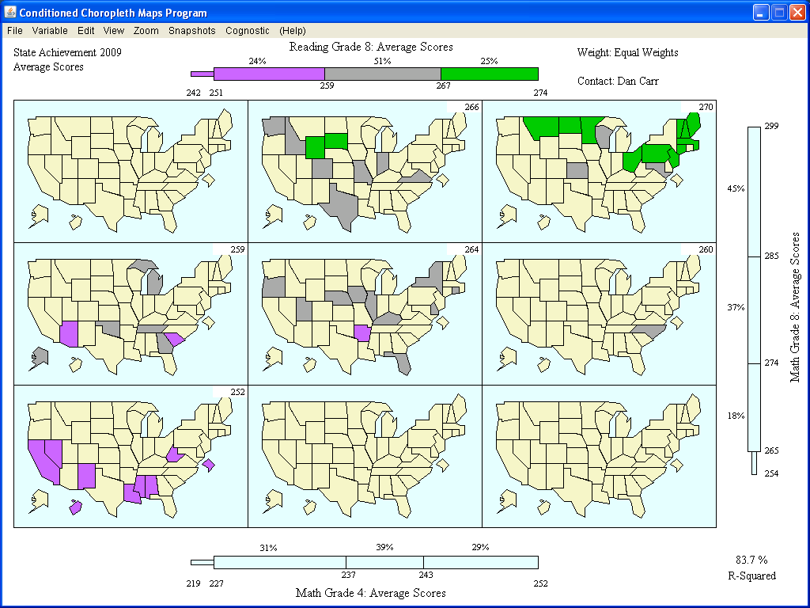

Slide 15
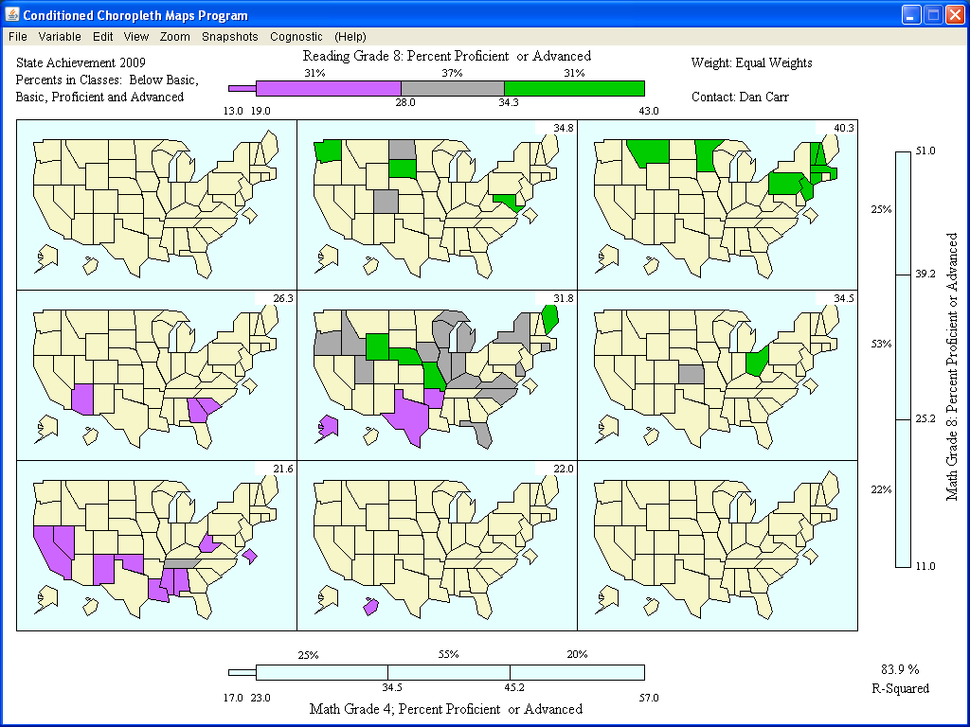

Slide 16
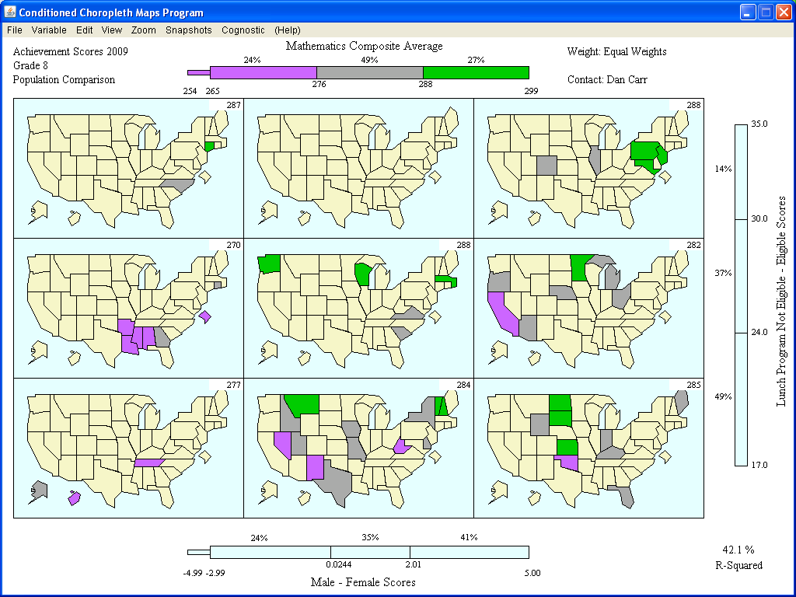

Slide 17
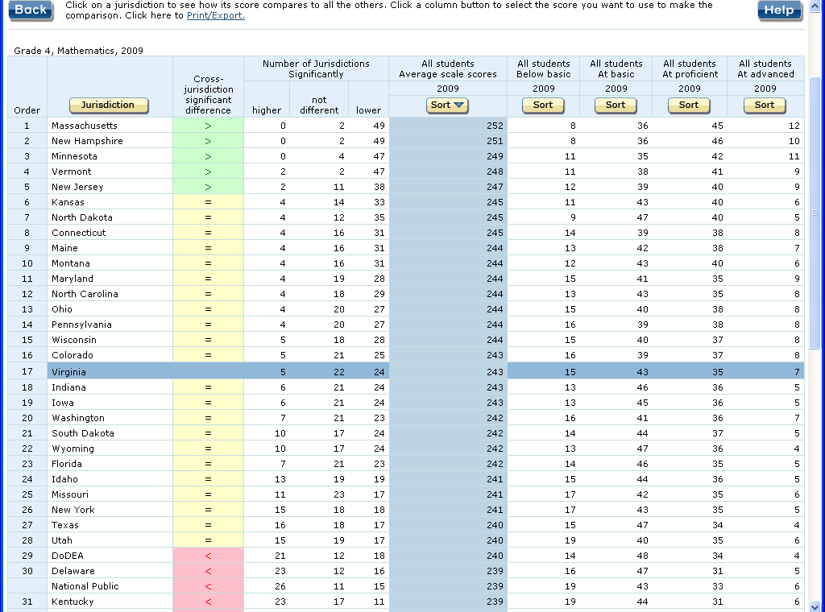

Slide 18
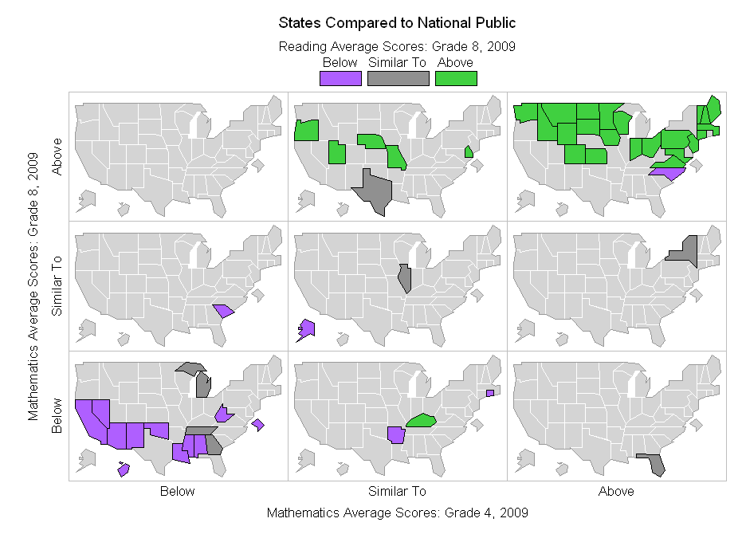

Slide 19
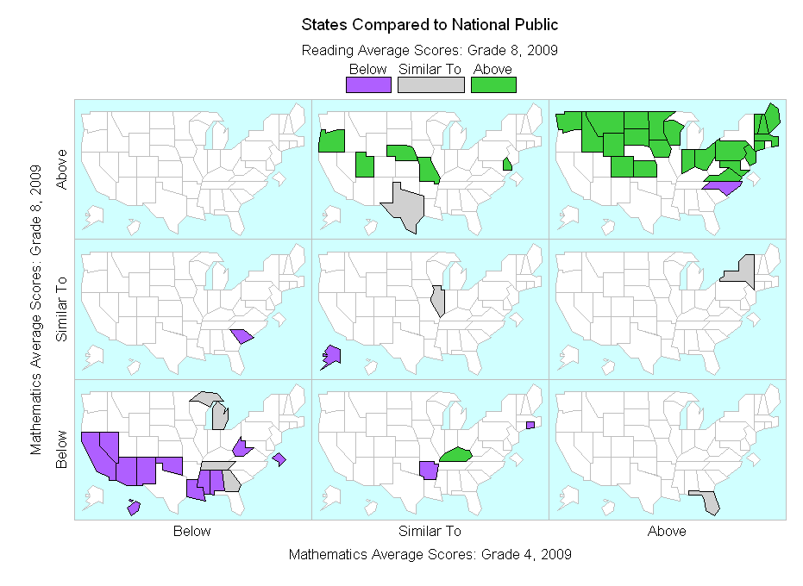

Slide 20
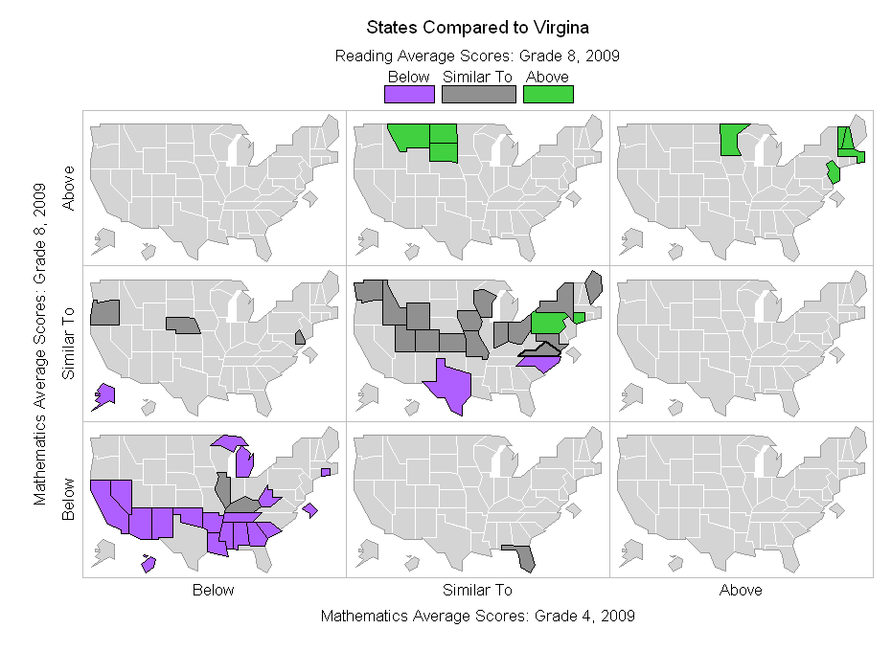

Slide 21
Comparative Micromaps
Shows one- and two-way indexed map series
Example indices year, age groups, categorical variables such as sex
Comparison considerations
Transformations: 1st and 2nd differences, ratios, percent change,
contrasts, trend removal, standardized mortality ratios
Change blindness
*Predictor variables and lags
Implementations and interactive options
R scripts
Java TCmaps (Temporal Change maps)

Slide 22
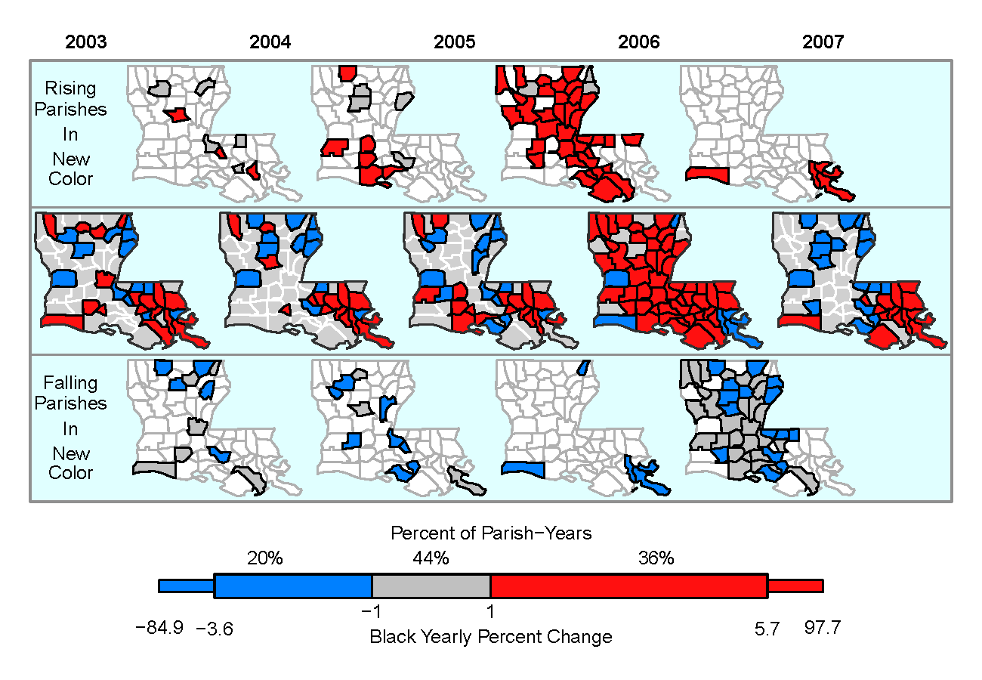
From Carr, D. B. and Pickle, L. W. 2010. CRC Press

Slide 23
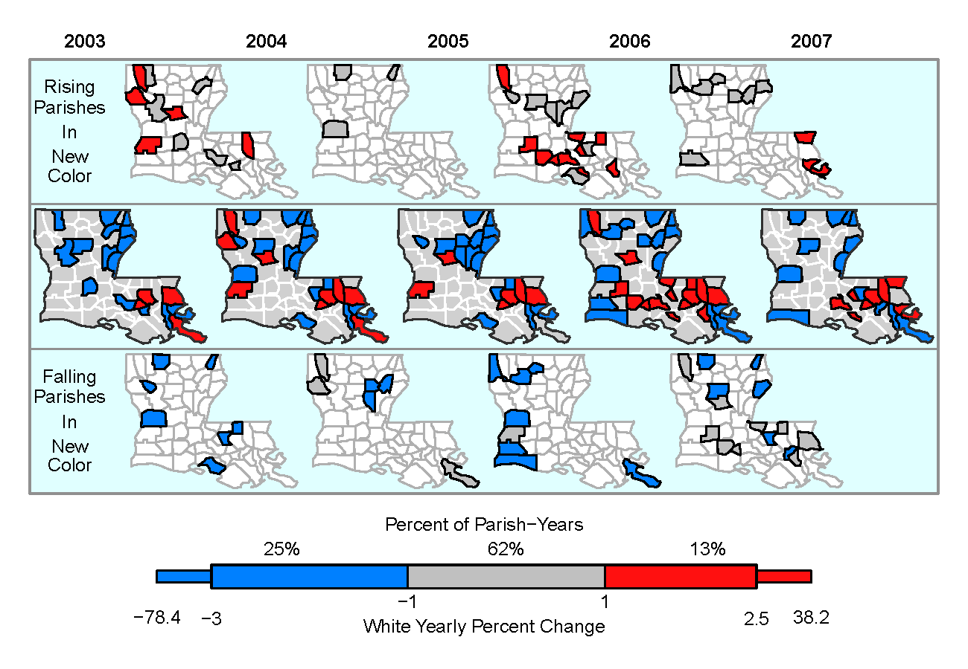
From Carr, D. B. and Pickle, L. W. 2010. CRC Press

Slide 24
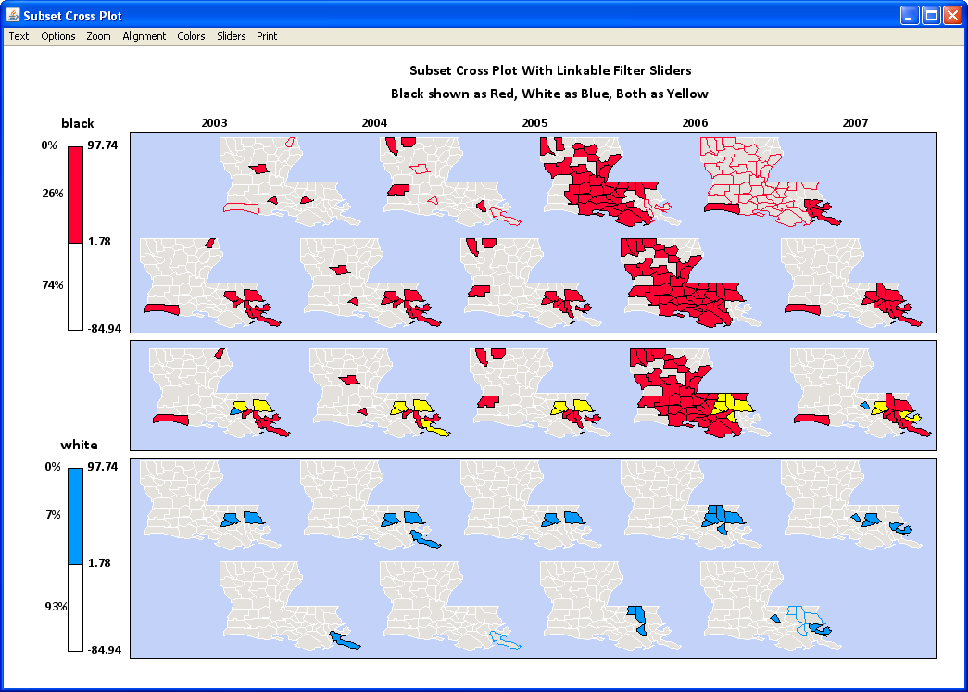

Slide 25
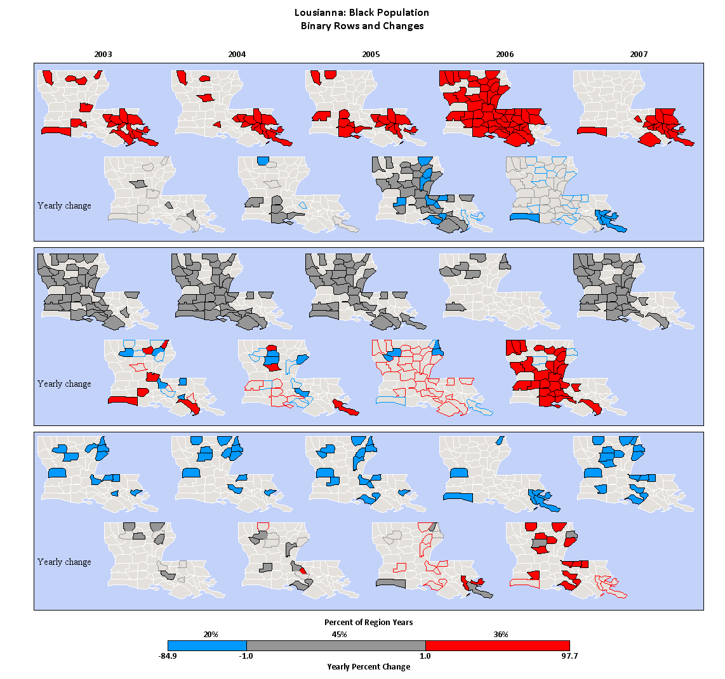

Slide 26
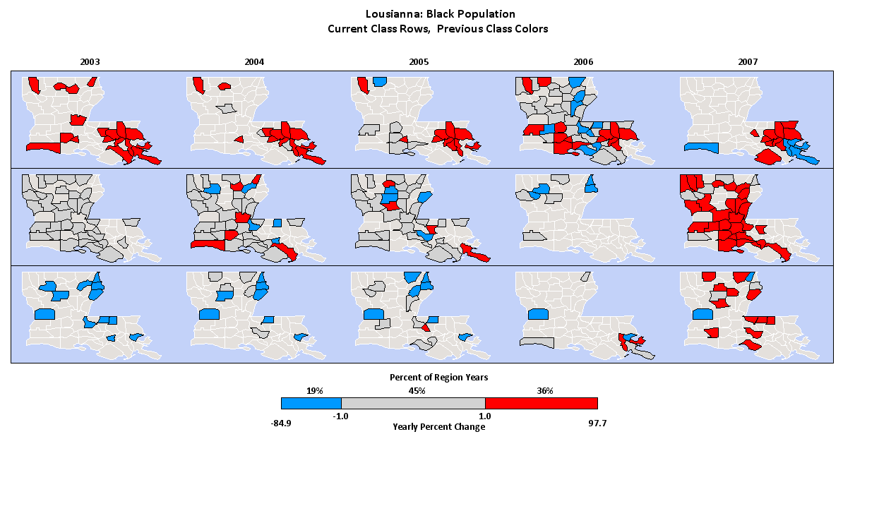

Slide 27
Some Instructive Alternatives
ESTAT: Alan MacEachren and team
http://www.geovista.psu.edu/ESTAT/
Exploratory Spatio-Temporal Analysis Tool Kit
Linked scatterplot, bivariate color map, time series plot, and parallel
coordinate plots
Gapminder: Hans Rosling
http://www.gapminder.org/
Animated scatterplots and animated bubble map
Scatterplots address change blindness with trails
Storytelling supported by focus a few nations, long sweep of time and
constrained variables such as life time, and zero births per woman
NameMapper (Assume Martin Wattenberg)
http://www.babynamewizard.com/name-mapper
Maps series (micromaps) with a continuous color saturation encoding,
enlarged view with mouse overs
Stack panel times series for individual states.

Slide 28
Micromaps Resources
Book Resources
http://mason.gmu.edu/~dcarr/Micromaps/
R scripts for Linked and Comparative Micromaps:
CCmaps (Java) for Conditioned Micromaps
Book and Contributed examples
Linked Micromaps
National Cancer Institute: Java http://gis.cancer.gov/tools/micromaps/
Jim Pearson: R Package (Soon)
Conditioned Micromaps
Michael Friendly SAS macro: http//www.math.yorku.ca/SCS/sasmac/ccmap.html
Comparative Micromaps
TCmap (Java) Contact: Dan Carr dcarr@gmu.edu
Dynamically Partitioned Network
DPnet (Java) Contact: Dan Carr
Three variables for streams, roads etc. (similar to CCmaps)

Slide 29
References
Carr, D. B. and Pickle L. W., 2010. Visualization Patterns in Data with Micromaps,
Chapman & Hall/CRC Press, Boca Raton, Fl.
Ware, C. 2008. Visual Thinking For Design. Morgan Kaufmann, New York.
Symanzik, J. and D. B. Carr. 2008 Interactive linked micromap plots for
interactive display of geographically referenced data. Handbook of Data
Visualization. Eds. / C Chen, W Hardle and A Unwin 267-294. Springer
Carr, D. B., D. White, and A. M. MacEachren. 2005. Conditioned Choropleth
Maps And Hypothesis Generation, Annals of Geography, 95(1), 32-53.
Carr, D. B, J. F. Wallin, and D. A. Carr. 2000. "Two New Templates for
Epidemiology Applications: Linked Micromap Plots and Conditioned
Choropleth Maps," Statistics In Medicine, Vol. 19, John Wiley & Sons,
pp. 2521-2538.

Slide 30
Data Access Recipe: State to Nation Comparisons http://nces.ed.gov/nationsreportcard/states/
1. Select Virginia or other State
Graphics on top right are interactive
2. Bottom left table: Select accessible version below table on bottom right
(Default is more graphics shown below)
Now Select variable by clicking Compare button
3. In the interactive table: Mouse on Nation Public row to change comparison
Above the table after BACK, left click on Print/Export
4. Next window: Check Box State Comparison Table
Chose the Radio Button for Excel
Click Done
5. Open with .xls file (Excel) despite file type mismatch
Possibly hand delete unwanted rows (header, footer)
Save as a .csv file with a name like NationMath2009G8.csv
6. Read this and other variable files to process with R or other Software

Slide 31
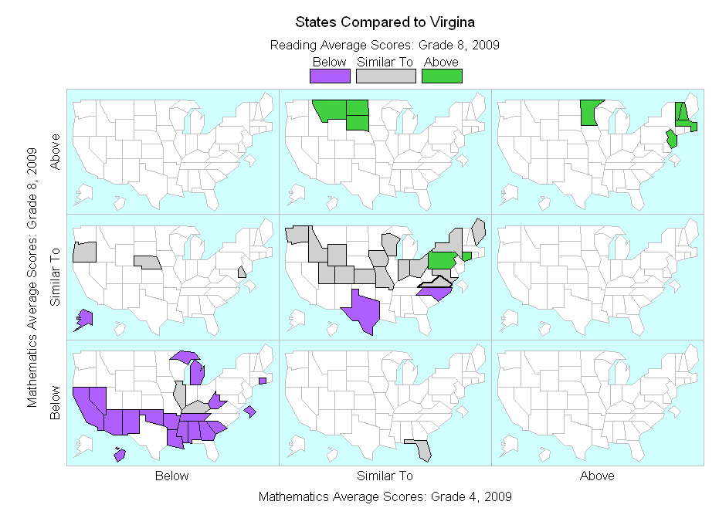

Slide 32
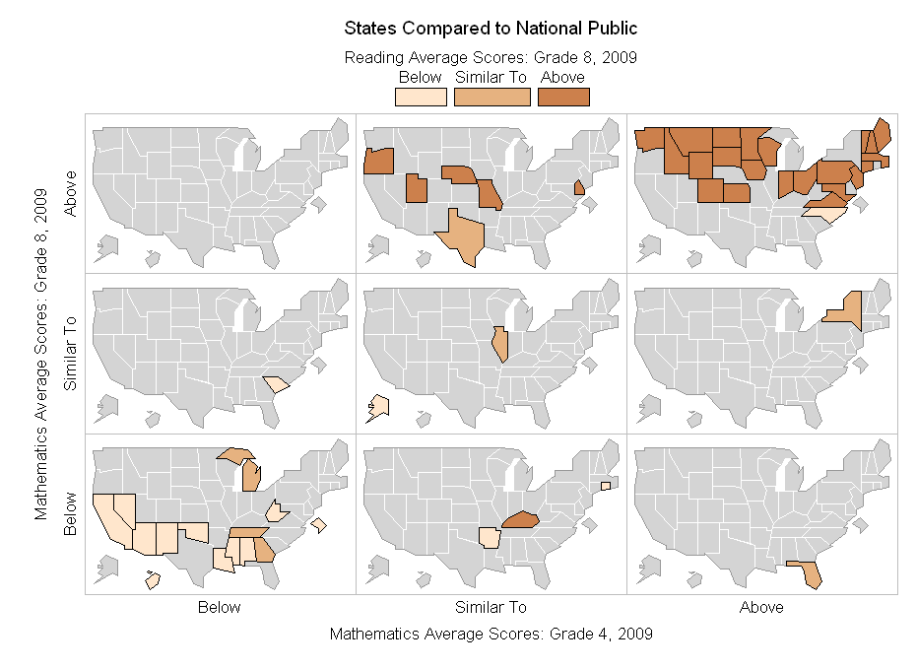

Slide 33
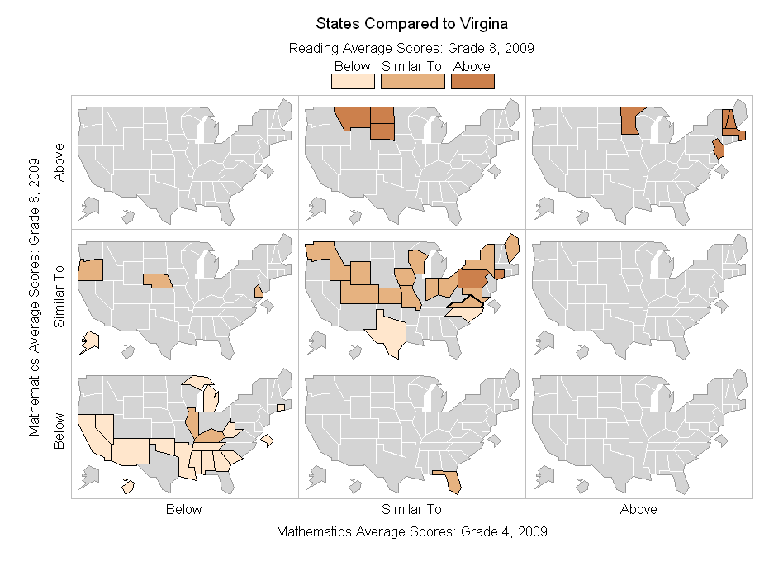

Slide 35
